Slide 1
RFM Customer Segmentation & Cohort Analysis Project
D1684 - Fehmi
D1240 - Rabia
D1562 - Brandon
D1228 - Gozde

Slide 2
Structure of the Project
Data Cleaning & Exploratory Data Analysis
RFM Analysis
Customer Segmentation
Applying K-Means Clustering
Creating Cohort and Conduction Cohort Analysis
Conclusion

Slide 3
Terminologies
InvoiceNo: Invoice number. Nominal, a 6-digit integral number uniquely assigned to each transaction. If this code starts with letter ‘c’, it indicates a cancellation.
StockCode: Product (item) code. Nominal, a 5-digit integral number uniquely assigned to each distinct product.
Description: Product (item) name. Nominal.
Quantity: The quantities of each product (item) per transaction. Numeric.
InvoiceDate: Invoice Date and time. Numeric, the day and time when each transaction was generated.
UnitPrice: Unit price. Numeric, product price per unit in sterling.
CustomerID: Customer number. Nominal, a 5-digit integral number uniquely assigned to each customer.
Country: Country name. Nominal, the name of the country where each customer resides.

Slide 4
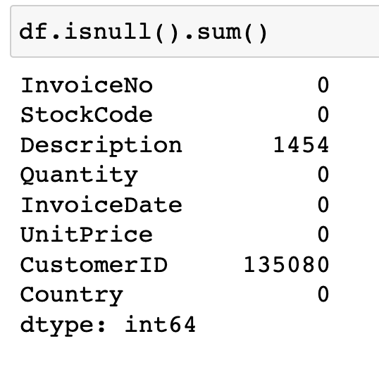
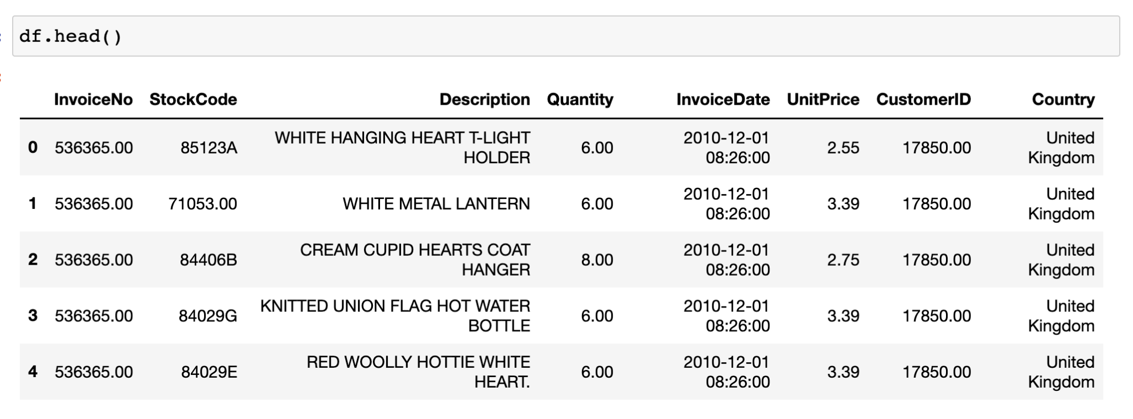
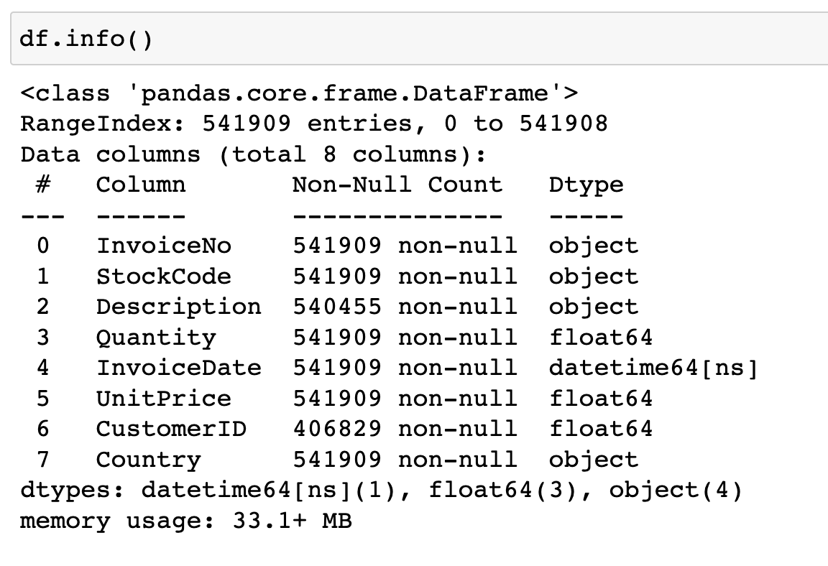
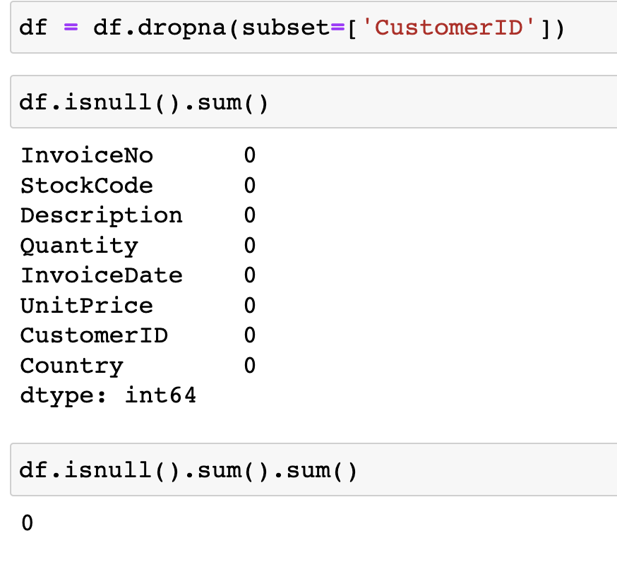
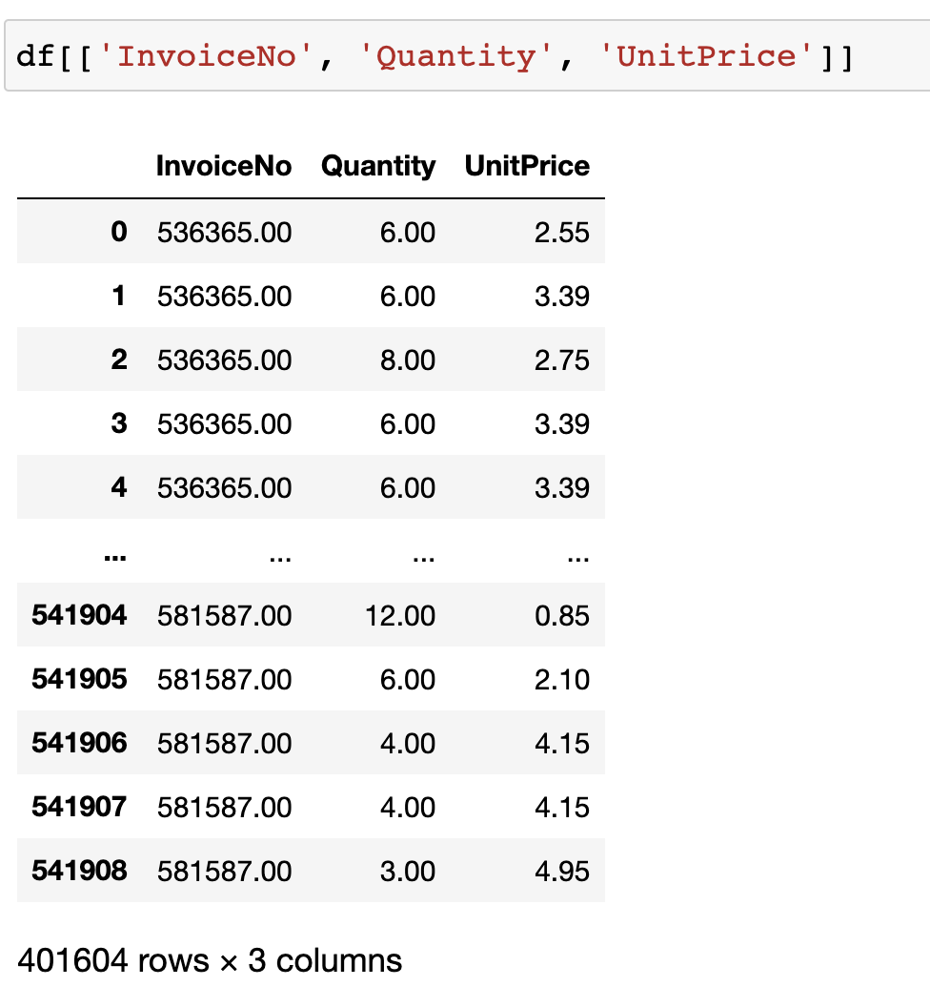
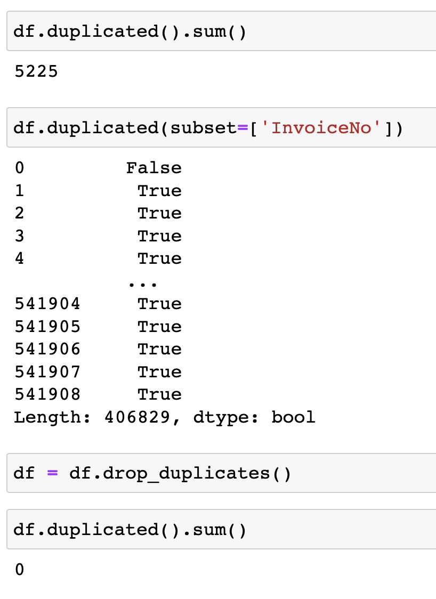
Data Cleaning & Exploratory Data Analysis

Slide 5
The Data
Notes:
This data set contains transactions occurring between 01/12/2010 and 09/12/2011 for a UK-based and registered non-store online retail. The company mainly sells unique all-occasion gifts. Many customers of the company are wholesalers.
We used the head() function to get the first 5 observations from the data.
Calling the info() function shows us the null value count and data types.

Slide 6
Null & Duplicated Values
Notes:
We used the .isnull() and the .sum() functions to get the sum of null values in each column.
Since we do not need them because they the CustomerID column is a unique value that’s why we don’t fill them out. So we used the .dropna() function to drop them.
Then we found the sum of duplicated values by calling the .duplicated().sum() function and dropped them as well.

Slide 7
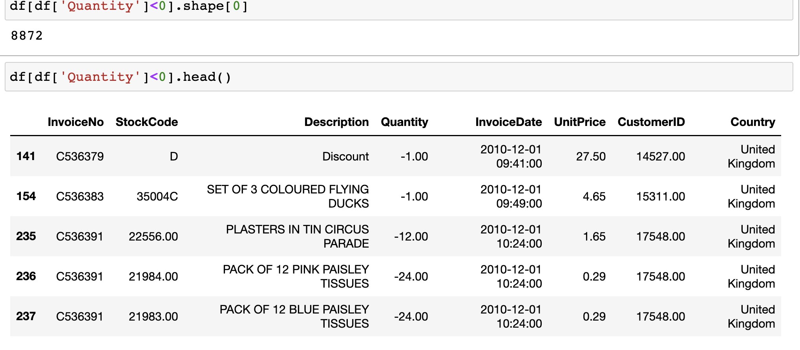
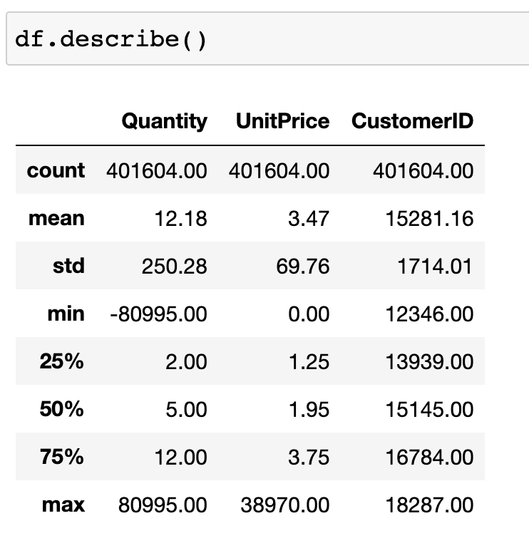
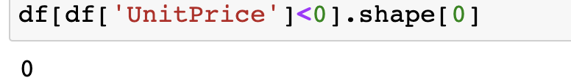
InvoiceNo, Quantity, and UnitPrice
Notes:
We examined the relationship between InvoiceNo, Quantity, and UnitPrice columns and found negative values. These values are a result of canceled and returned orders. We examined the negative values and determined that they are not useful since we only need the spending value of the customers.

Slide 8
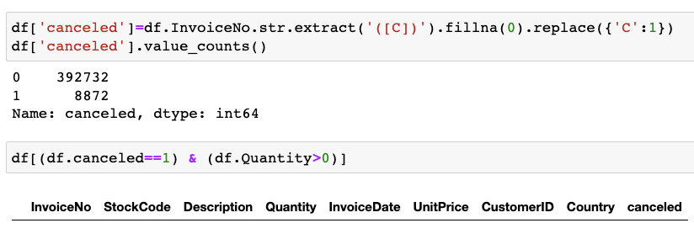
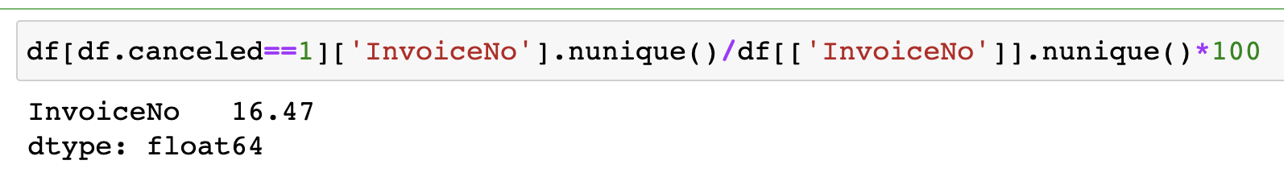
Canceled Order
Notes:
If the invoice number starts with the letter "C", it means the order was cancelled. Or those who abandon their order.
When we filter canceled orders by Quantity> 0 or filter non-canceled orders by Quantity <0 nothing returns, this confirms that negative values mean the order was canceled.
We can see that 16.47% of the order have been canceled.

Slide 9
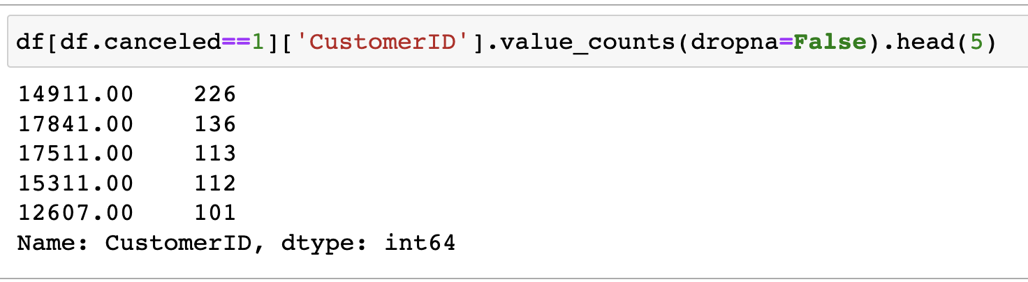
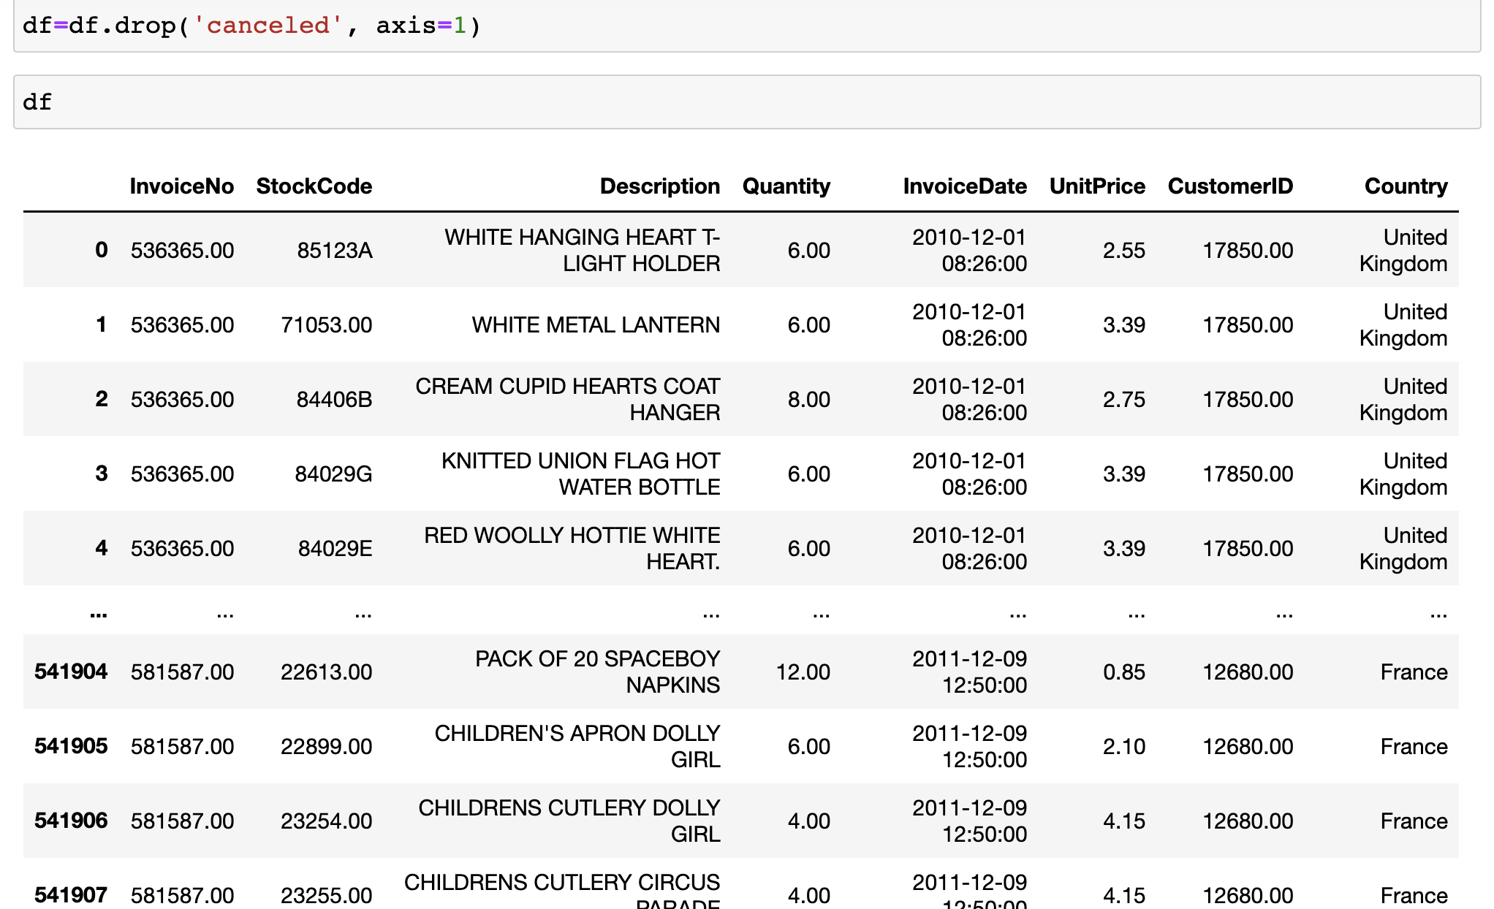
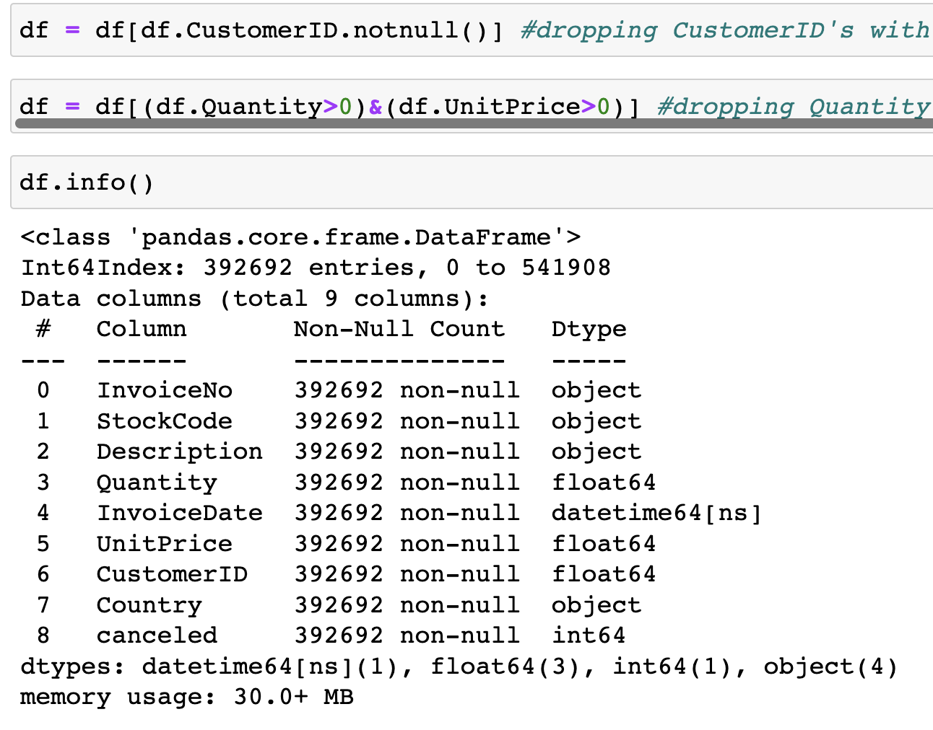
Handling & Cleaning Missing Values
Notes:
Since the customer ID's are missing, let’s assume these orders were not made by the customers already in the data set because those customers already have ID's.
We also don't want to assign these orders to those customers because this would alter the insights we draw from the data.
When we investigated the canceled values we found that UnitPrice and Quantity columns contained negative values.
Therefore, we used the .drop() function to get rid of them.

Slide 10
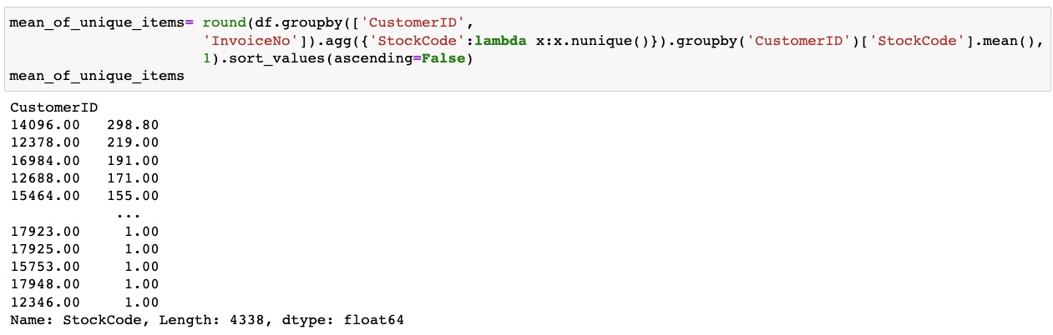
Unique Items
Notes:
We found the average number of unique items per order We used .groupby() function to group by CustomerID and InvoiceNo.

Slide 11
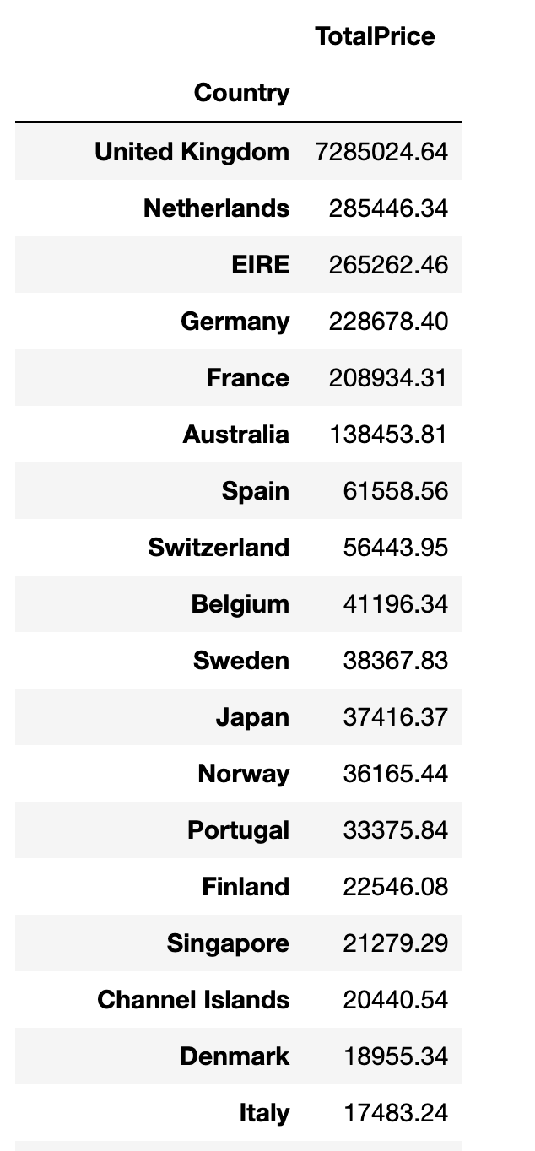
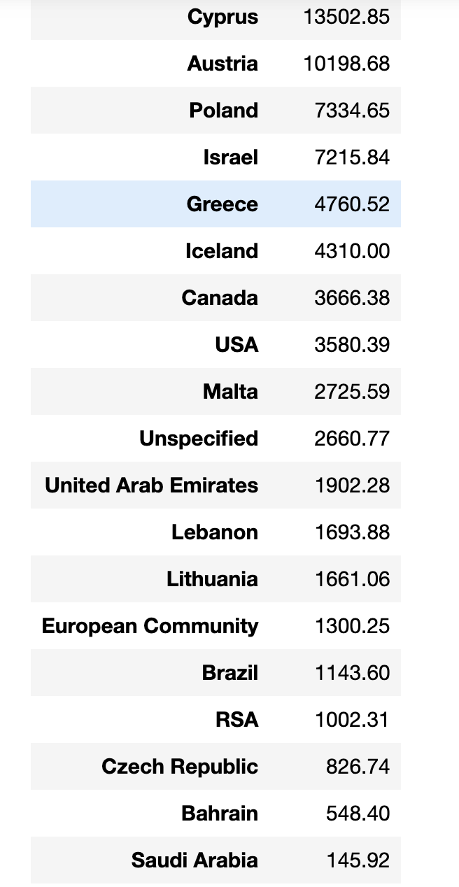
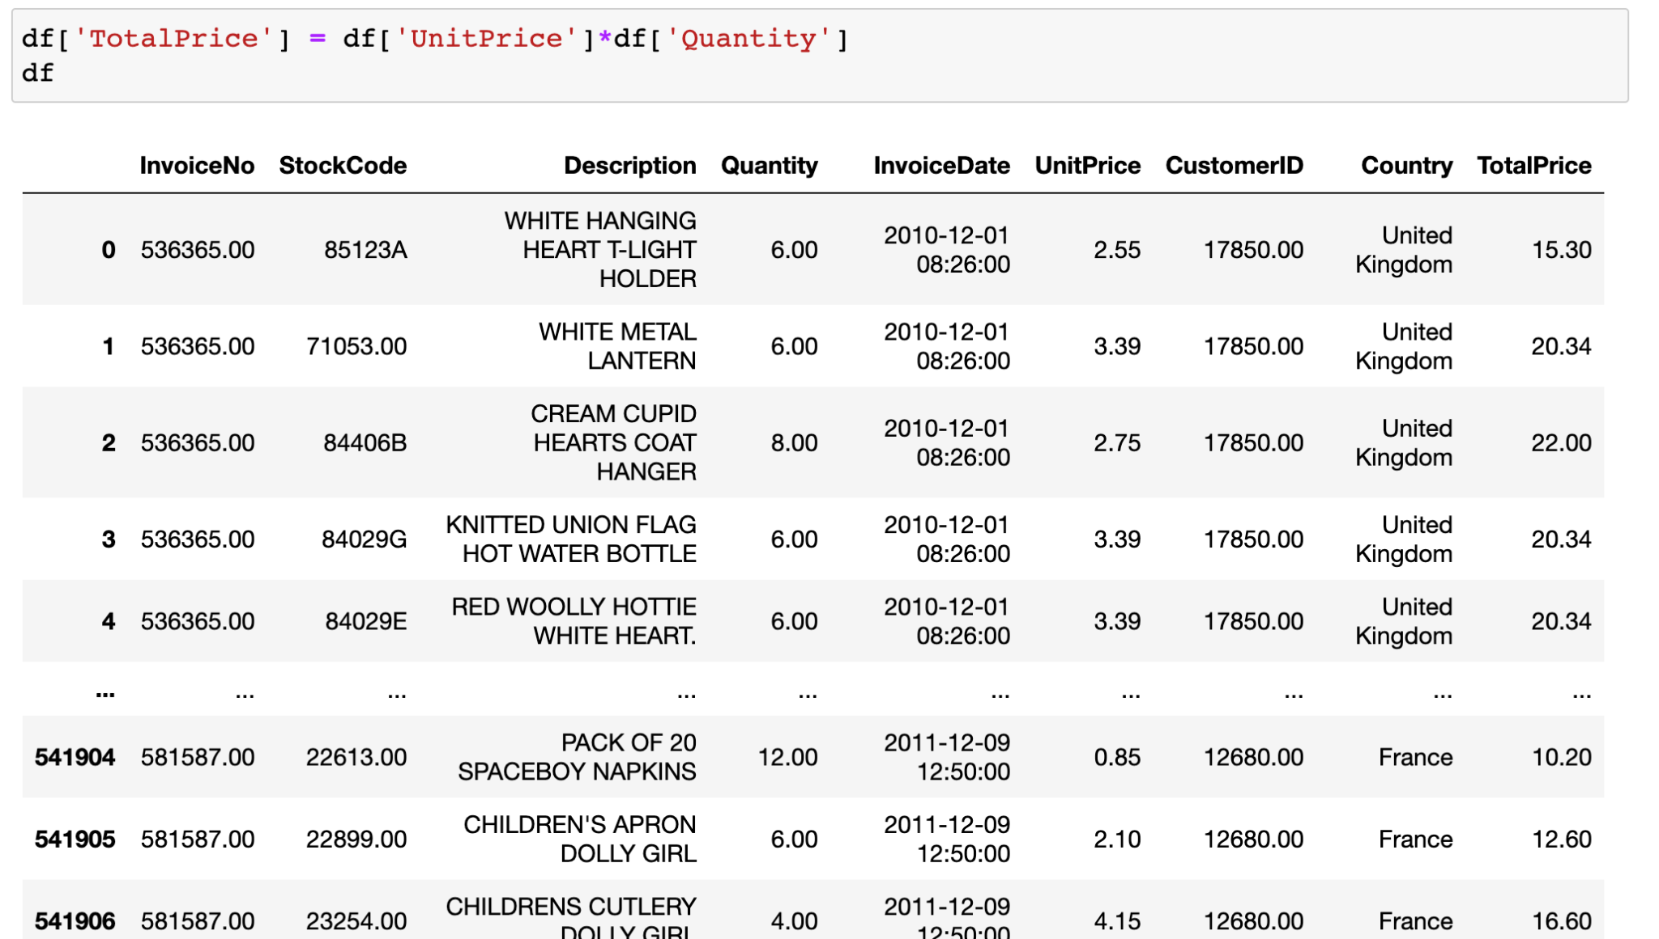
Customers by Country
Notes:
We created a new column titled TotalPrice by multiplying UnitPrice and Quantity. Then we used the groupby() function and grouped it by Country to see each country’s spending amount.

Slide 12
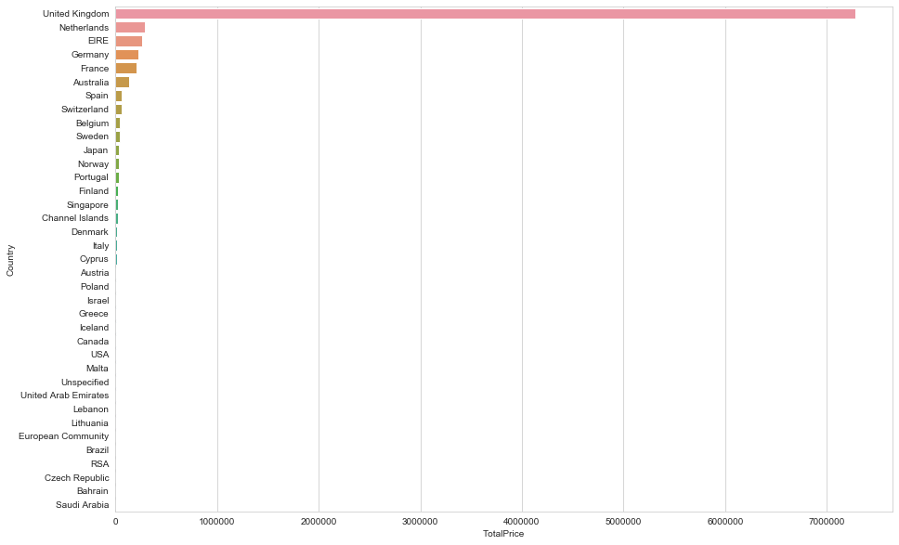
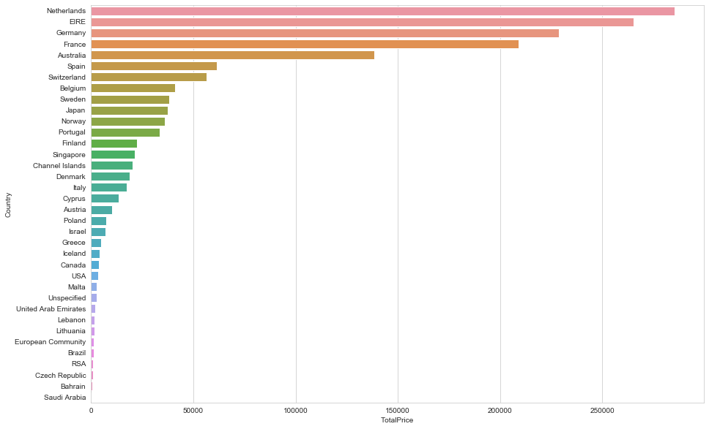
Cont.
Notes:
We observed that United Kingdom spent the most compared to other countries.

Slide 13
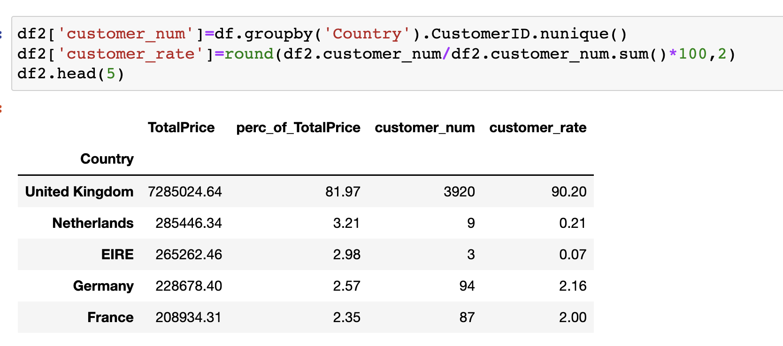
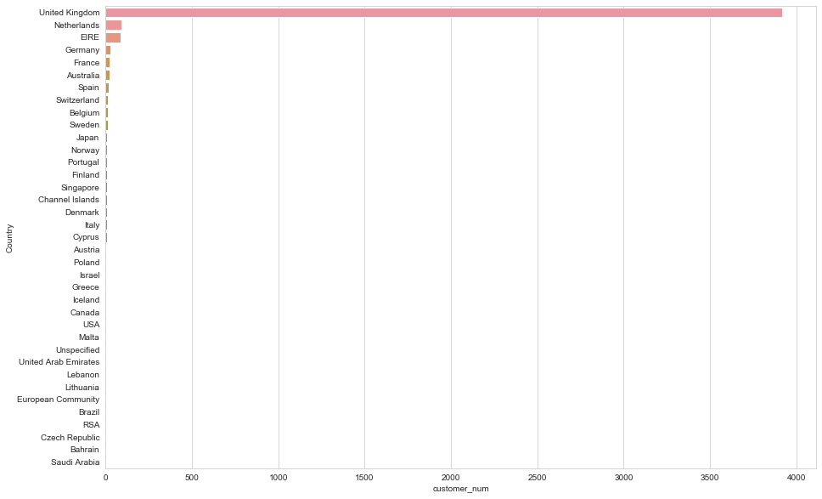
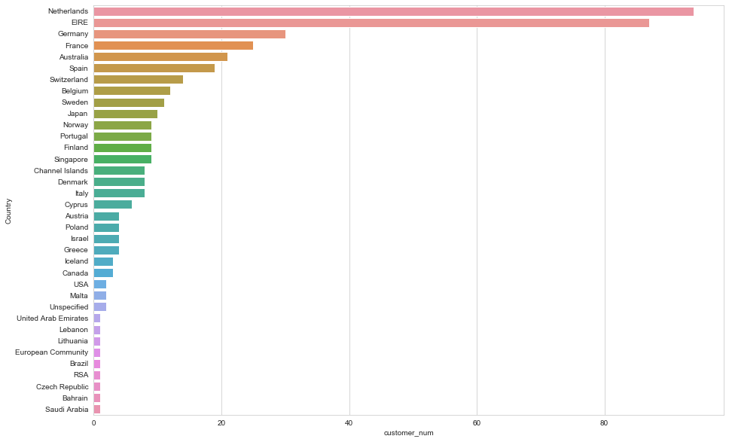
Cont.
Notes:
The UK not only has the most sales revenue, but also the most customers. Since the majority of this data set contains orders from the UK, we can explore the UK market further by finding out what products the customers buy together and any other buying behaviors to improve our sales and targeting strategy.

Slide 14
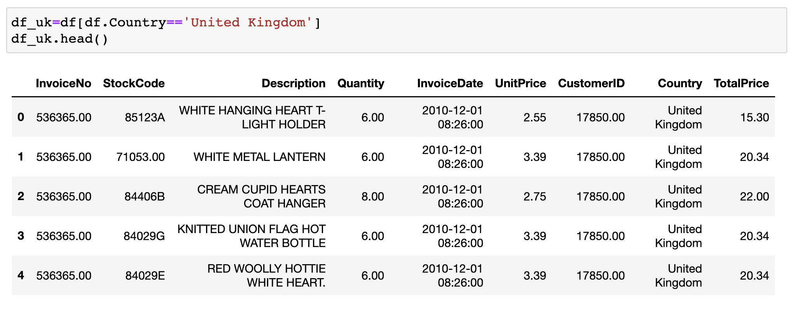
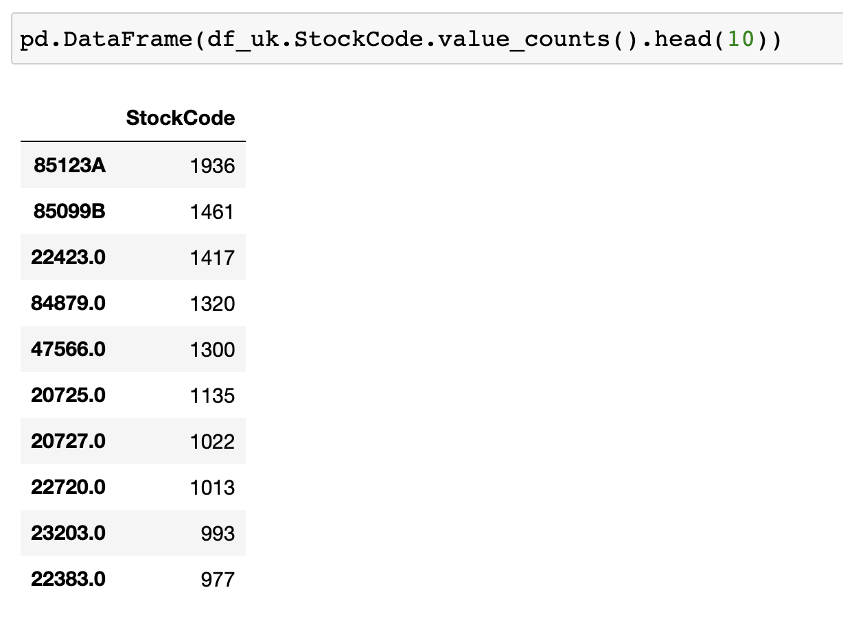
The UK Market
Notes:
UK dataframe
Most popular products bought in UK
This is why we decided to focus on the UK market and created a new data frame.

Slide 15
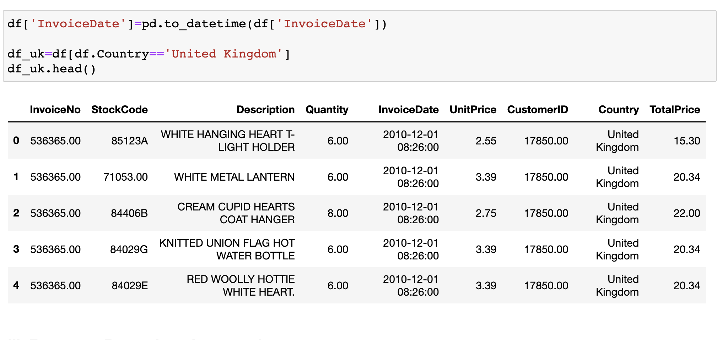
RFM Analysis
Recency: Time since last purchase
Frequency: Total number of purchases
Monetary: Total monetary value
Notes:
We did a RFM Analysis because it is a customer segmentation technique that focuses on past purchase behaviors of the customers. We divided the past purchase behaviors into three groups: Recency, Frequency, and Monetary.

Slide 16
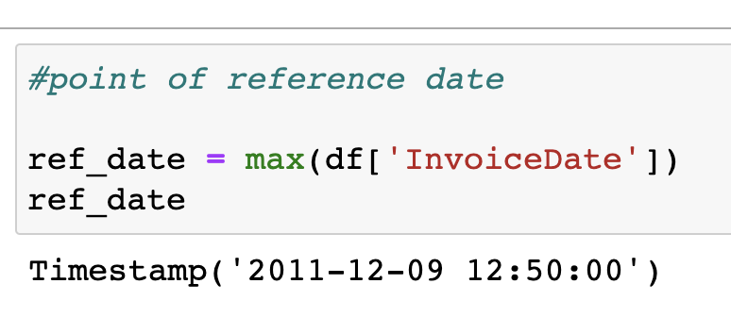
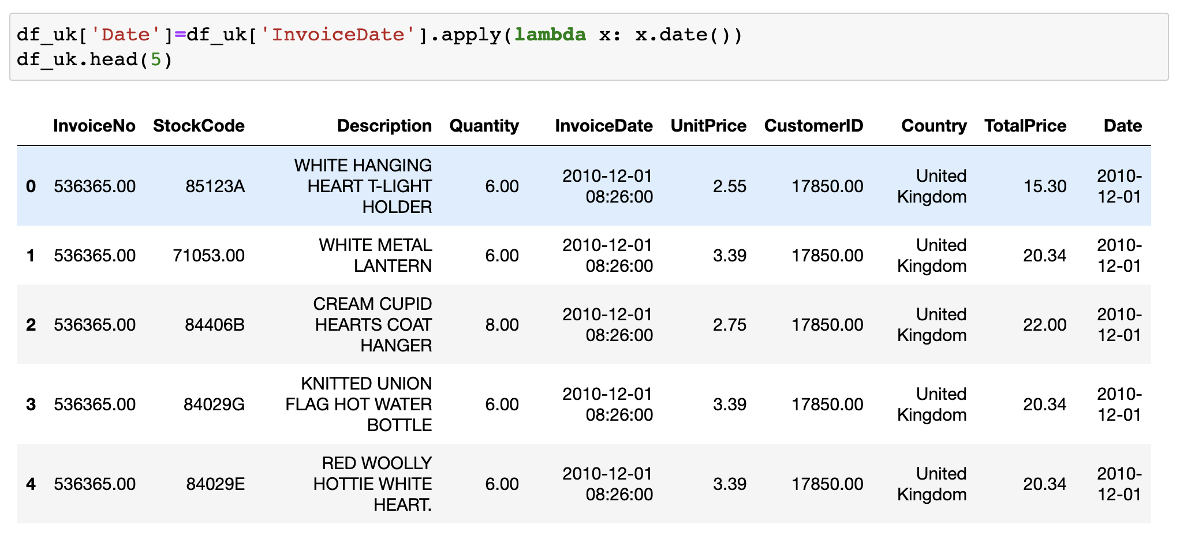
Recency
1.
2.
Notes:
We calculated the recency by choosing a data as our point of reference to evaluate how many days ago the customer’s last purchase was.
Then we created a new column titled Date with the InvoiceDate but without the timestamp.

Slide 17
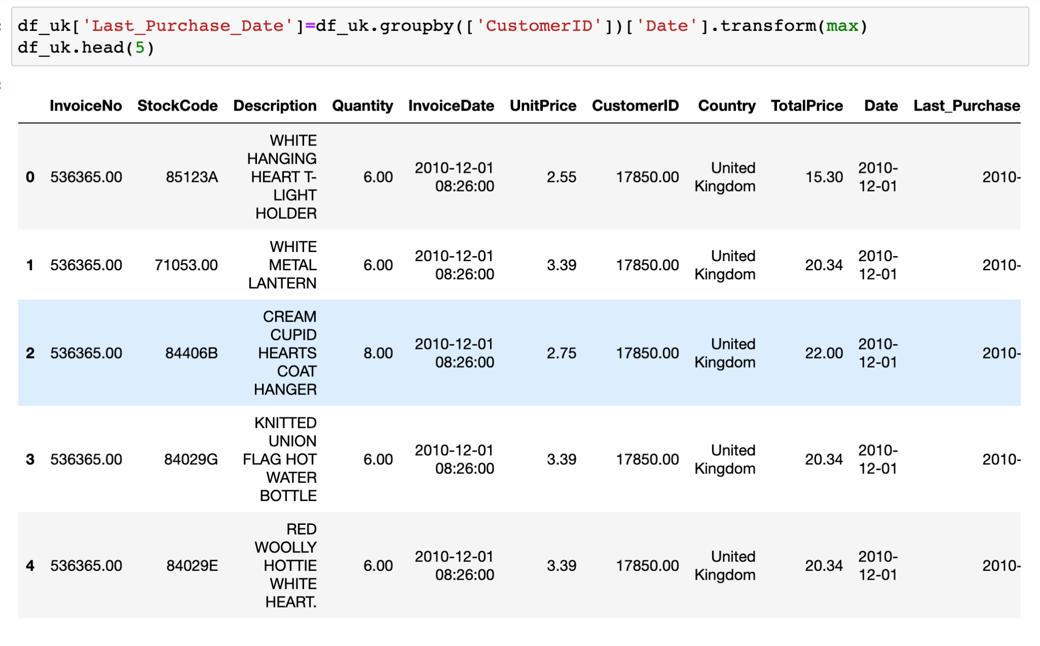
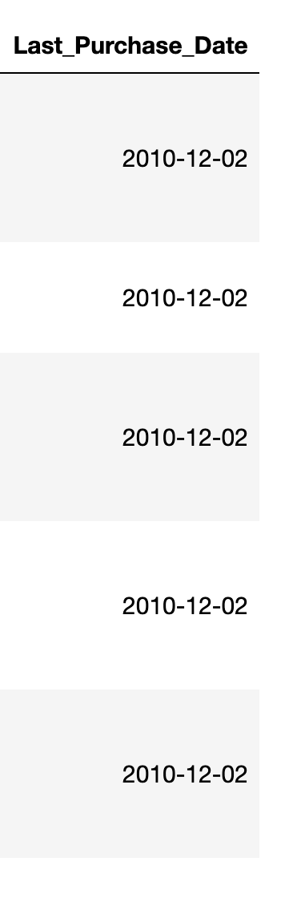
Cont.
3.
Notes:
3. We grouped it by CustomerID to check the last purchase dates of the customers.

Slide 18
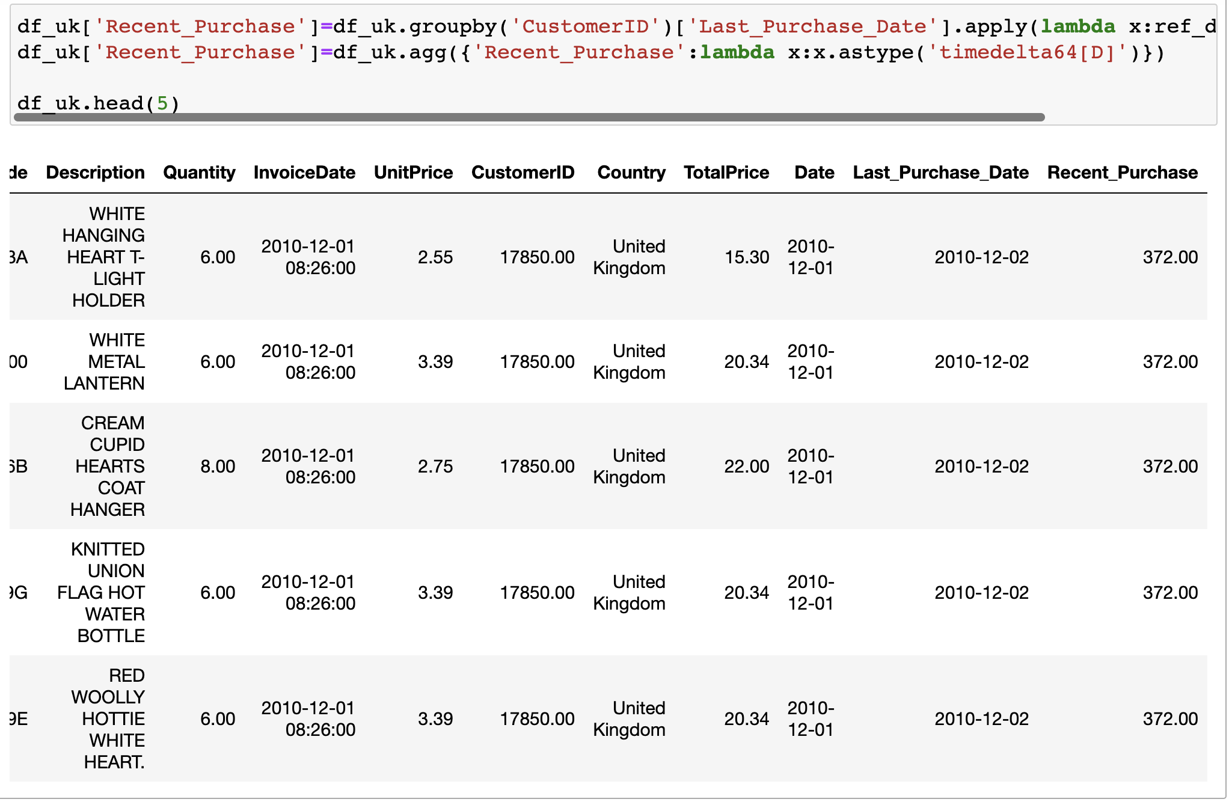
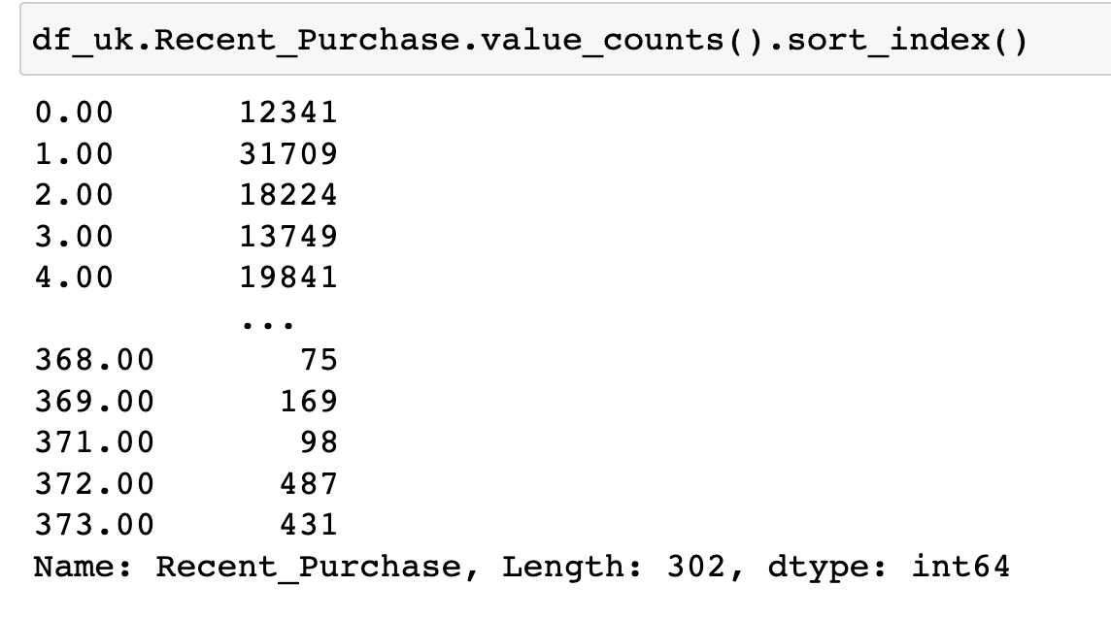
Cont.
4.
Notes:
4. Then we calculated the days since last purchase.

Slide 19
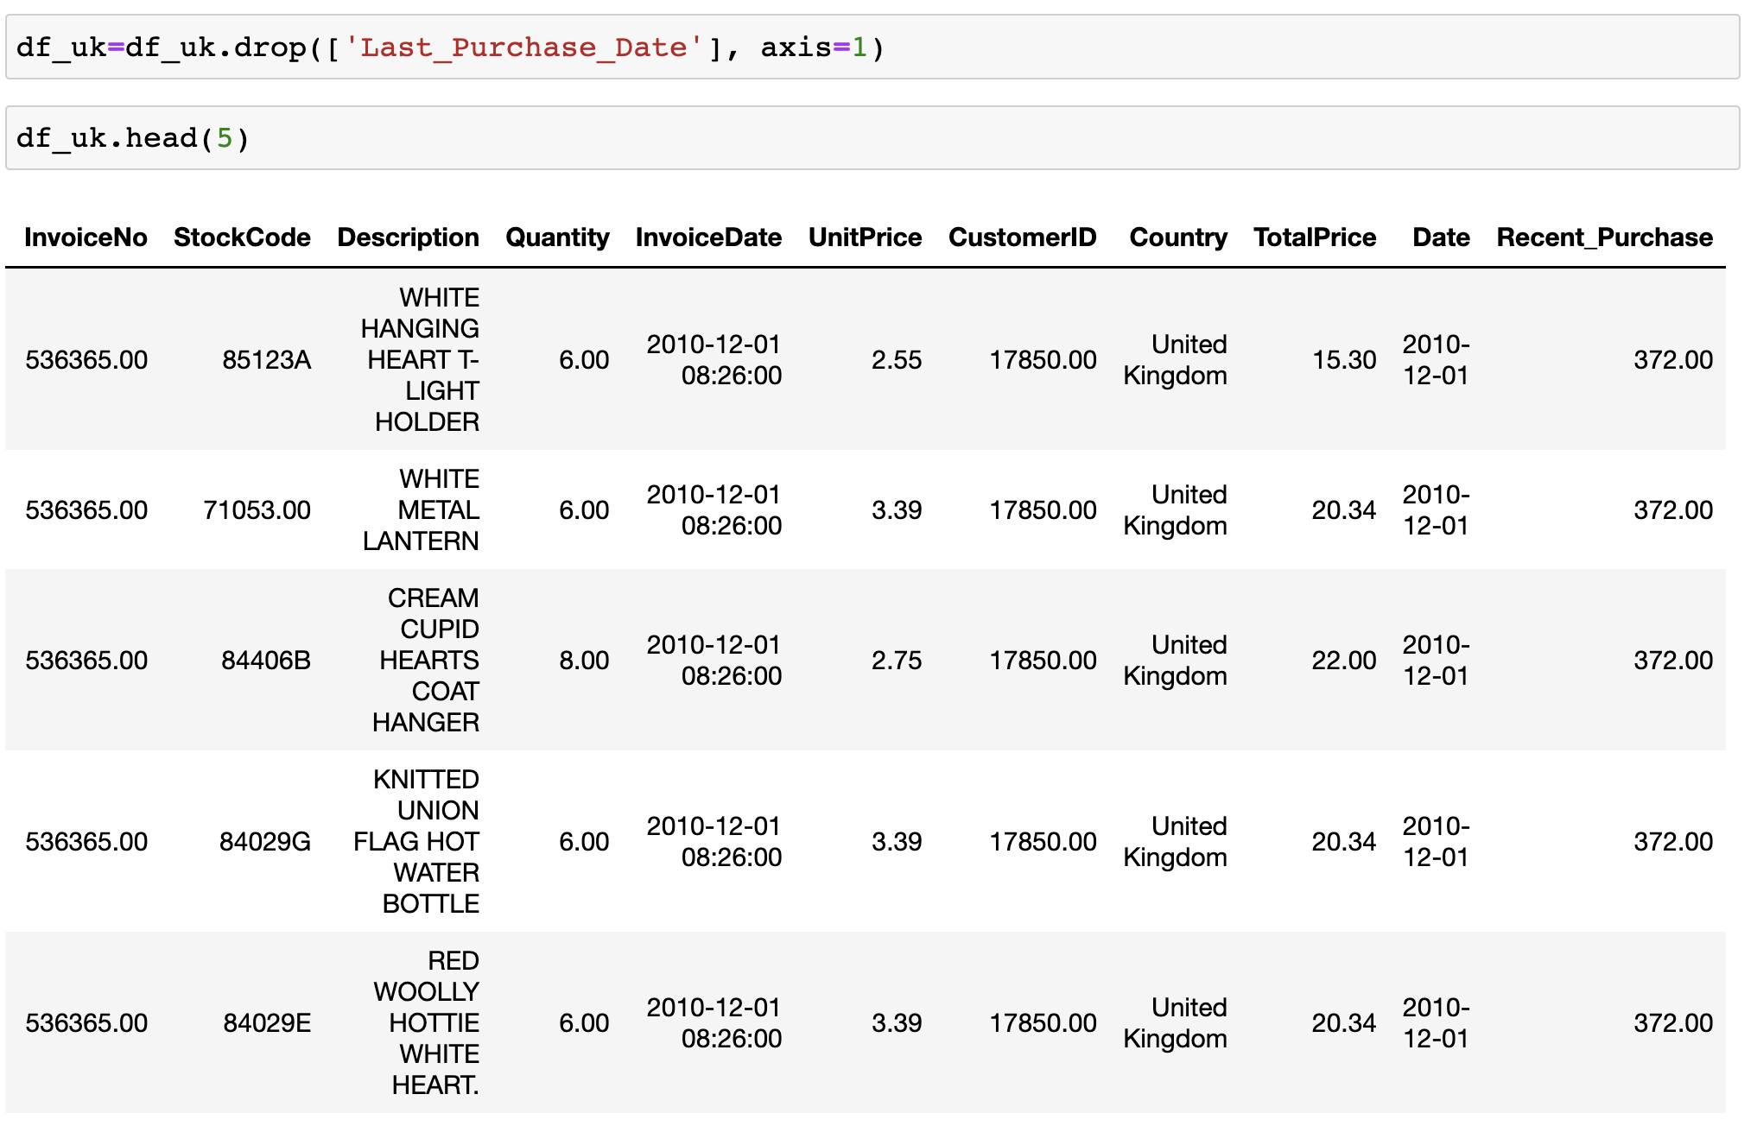
Cont.
5.
Notes:
5. Since we do not need the Last_Purchase column anymore we used the drop() function to drop it.

Slide 20
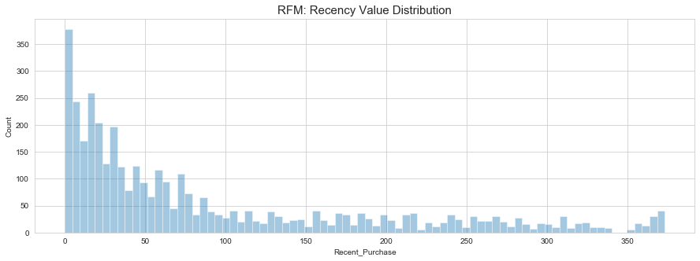
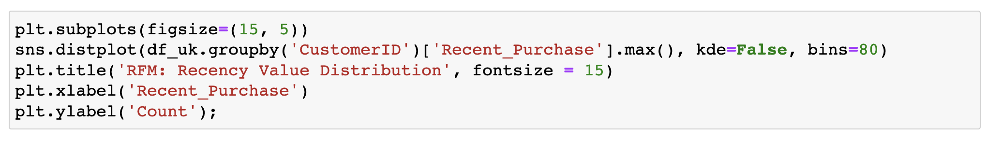
Cont.
6.
Notes:
6. We created a plot to show how long ago a customer’s last purchase was.

Slide 21
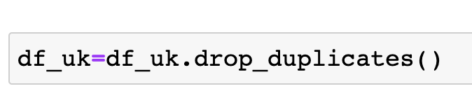
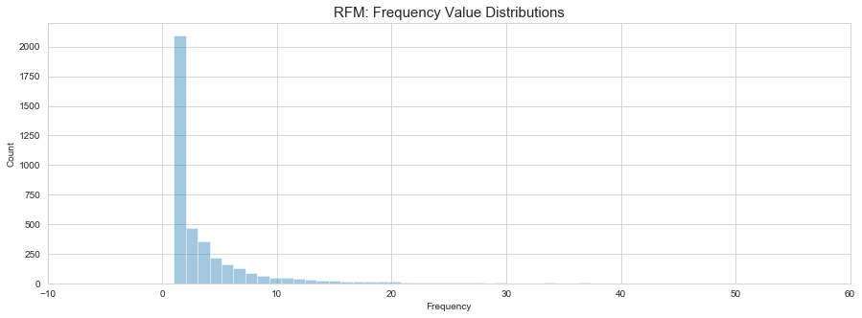
Frequency
Notes:
We calculated the purchase frequency of a customer.

Slide 22
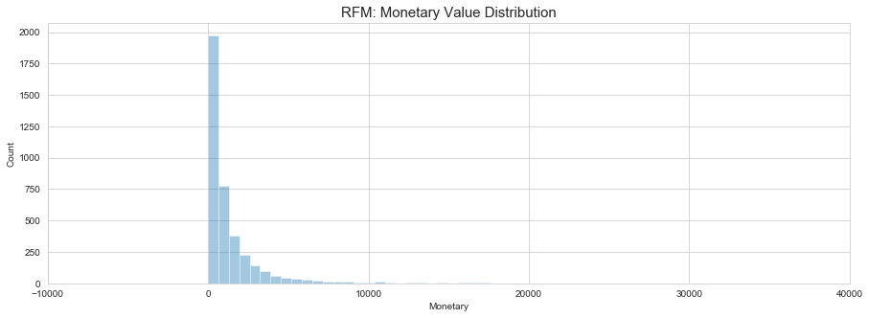
Monetary
Notes:
We calculated the total amount of money spent by each customer.

Slide 23
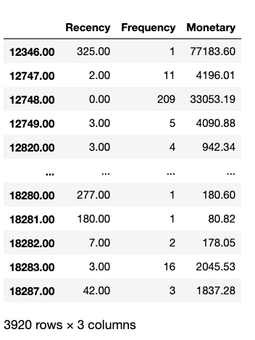
RFM Table
Notes:
This just shows the RFM for each customer.

Slide 24
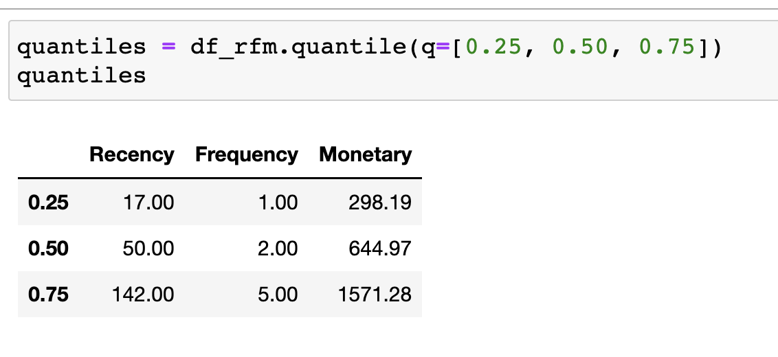
Customer Segmentation
Notes:
Customer Segmentation is a process of separating customers into groups based on certain criteria such as spending, habits, interests, and Recency-Frequency-Monetary.
We created a definition for quantile and in it we separated our customers into 4 quartiles.

Slide 25
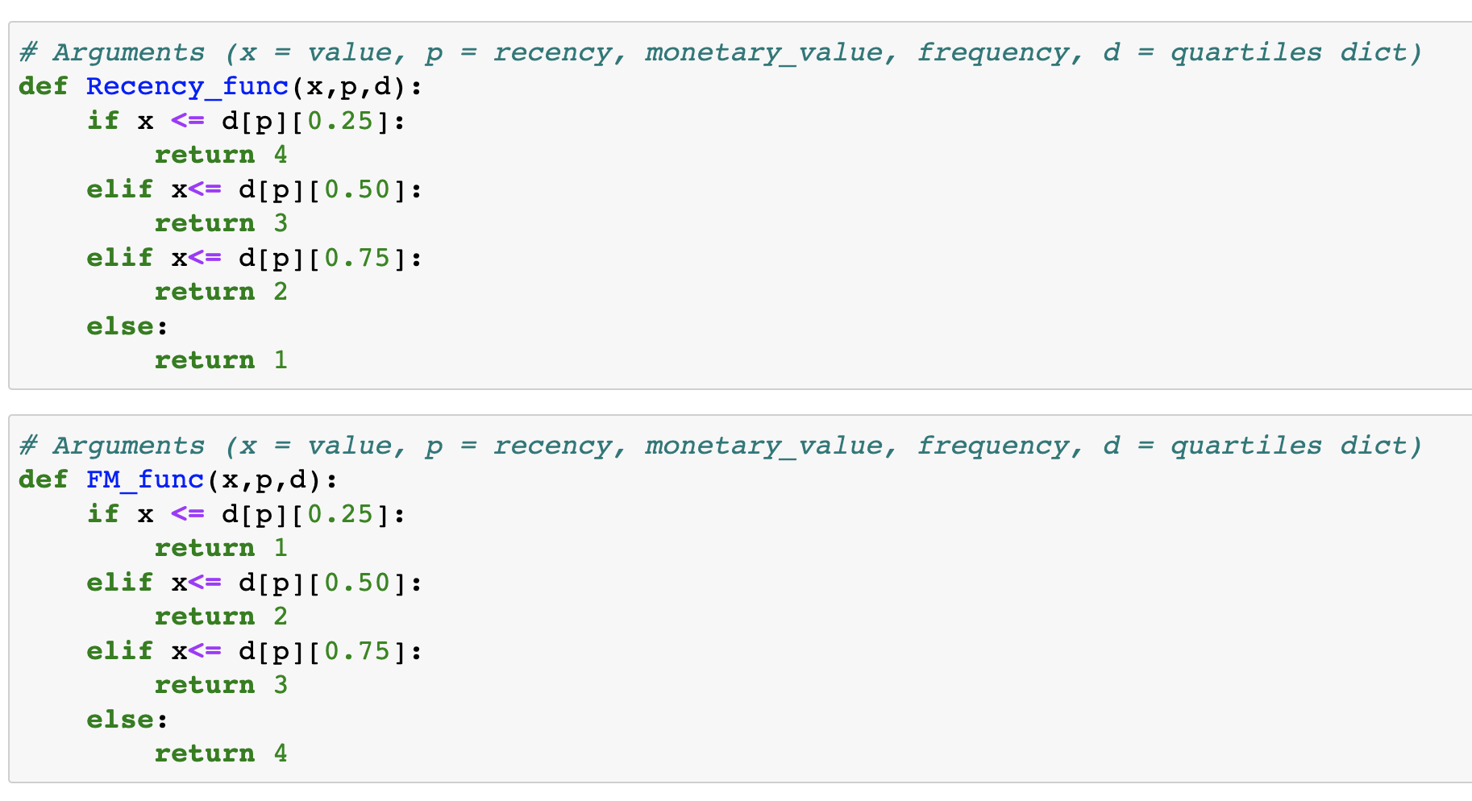
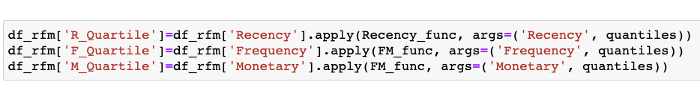
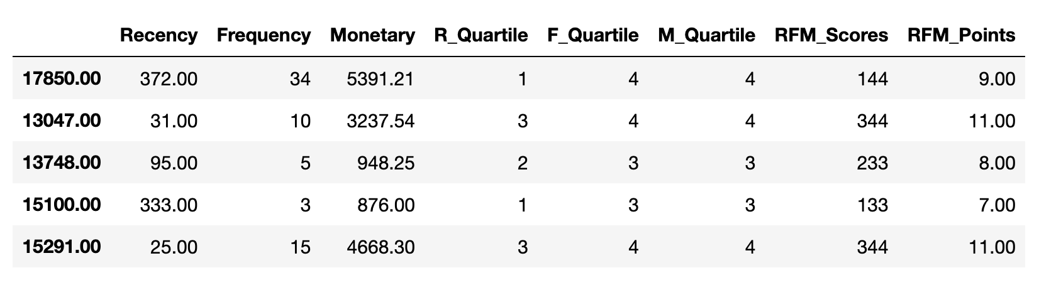
RFM Segmentation Table
Notes:
We created two functions to calculate the Recency, Frequency, and Monetary scores.
We then added columns for each customer and their calculated scores
Recency Scores: 4 is the highest indicating a customer has purchased the most recent, 1 is to show a customer has not purchased recently
Frequency and Monetary Scores: 1 is the highest and shows a customer has spent more money frequently, 4 is the lowest and shows a customer does not spend as much money or shop as frequent

Slide 26
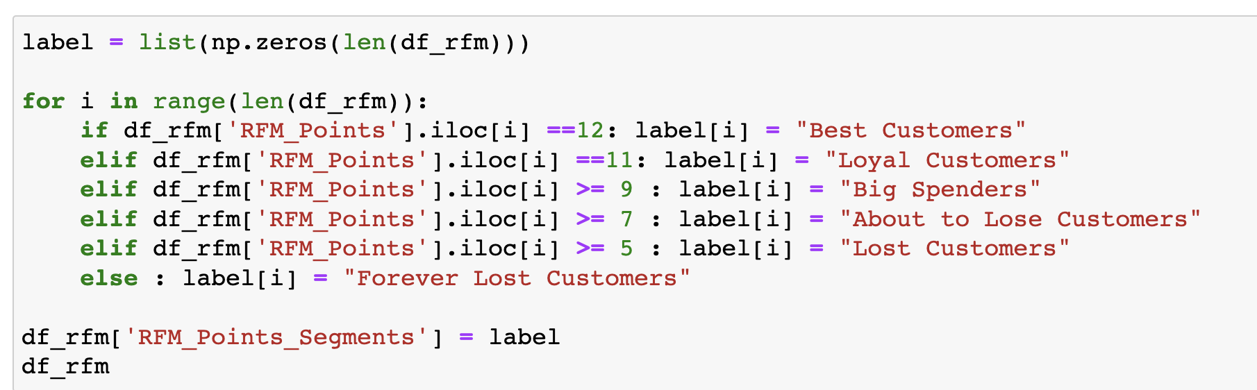
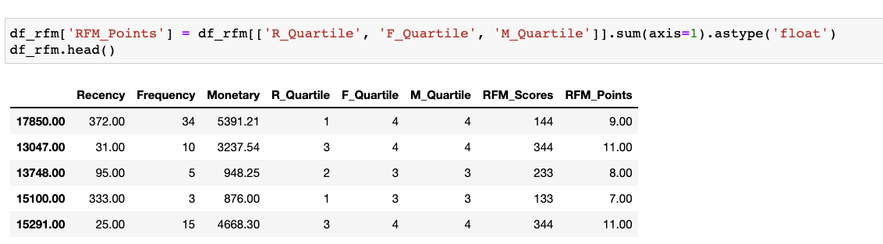
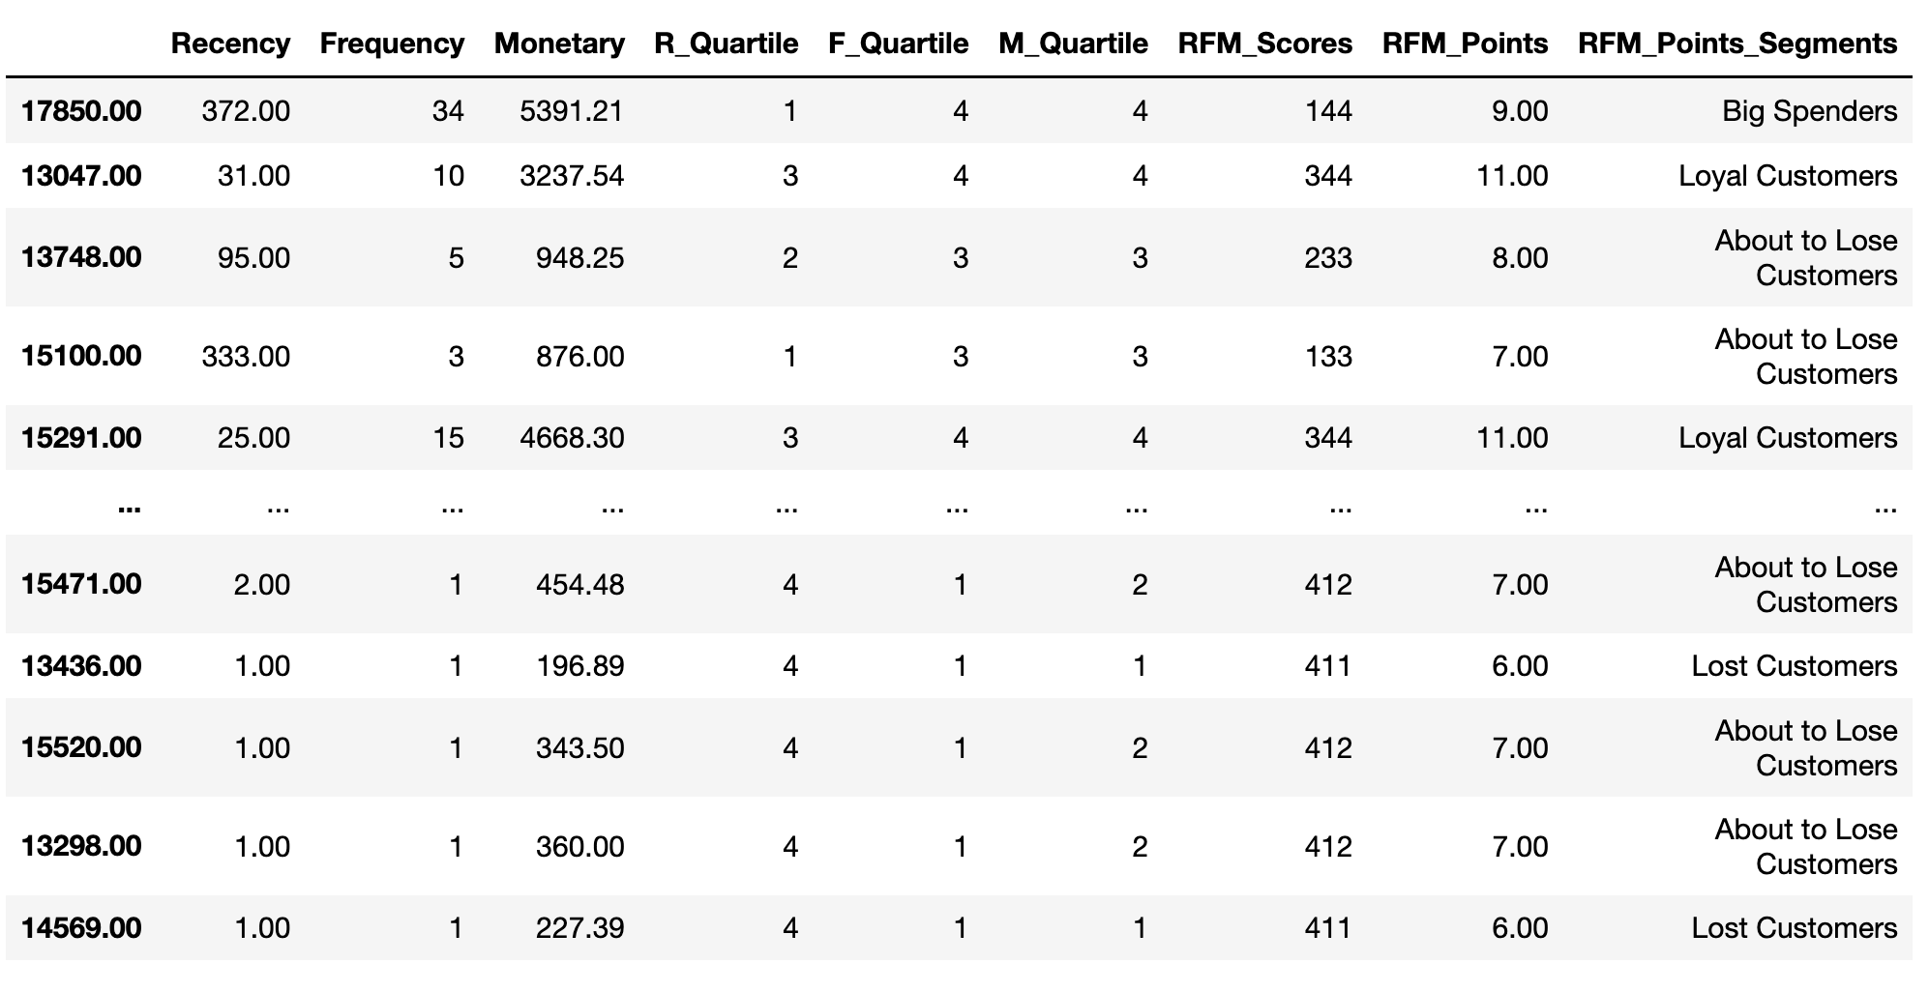
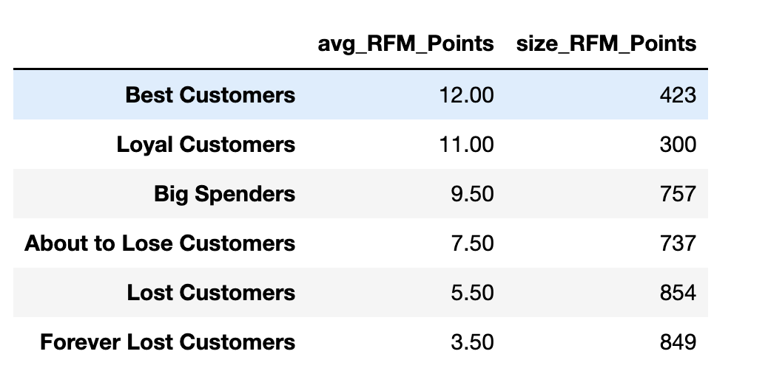
Creating Labels
Notes:
First we created a column for RFM Points by getting the sum on each customer’s RFM Score.
Then we created a ‘for’ loop to label each customer’s RFM Points and divided them into 6 categories based spending habits. The categories we chose were dependent on the score we thought best fit according to customer spending habits.
After creating the RFM_Points_Segments, we found the average of each category from the corresponding group of customers. The size_RFM_Points column includes the total number of points from each category.

Slide 27
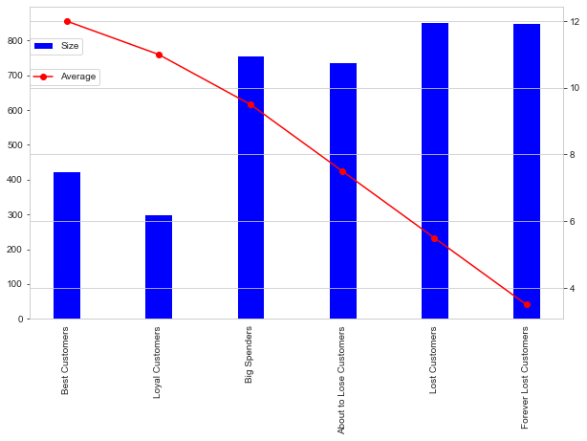
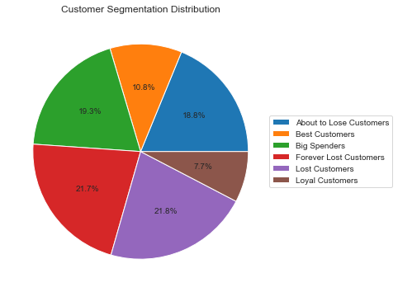
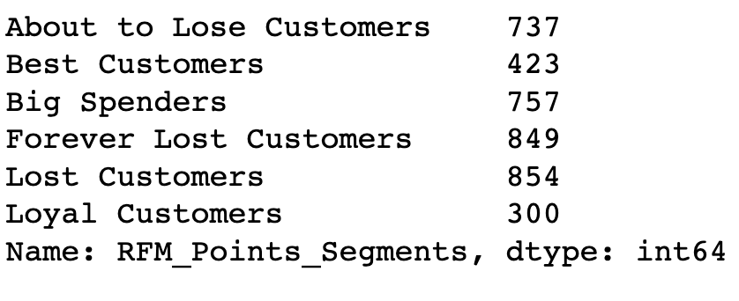
RFM Segments
Notes:
Pie Chart: percentage of each segment category
Bar Chart: shows count of customers in each segment category

Slide 28
Applying K-Means Clustering
Notes:
In K-Mean clusters are important because clusters are collection of data points aggregated together because of certain similarities.

Slide 29



InvoicePeriod
Notes:
We created the InvoicePeriod column because we are interested in the spending of each customer per month.
In the df_line dataframe we grouped it by InvoicePeriod and got the sum of TotalPrice of each unique customer.
This graph shows the number of unique customers as well as the sum of total price per month.

Slide 30

Life-span
Notes:
We created a life_span column in order to get the number of days between each customers first purchase and last purchase. Recency only gives number of days between the customers’ last purchase and reference date.

Slide 31





K-Means Implementation
Notes:
It is important to scale in algorithms where there is a distance between points. For example, K-means, knn, svm. This is why we scale our data.
We use hopkins test because if the hopkins score is less than 0.5 then applying clustering is suitable. Our hopkins score is 0.09 which means that the clusters are good.
We created a for loop and calculated the sum of squared distances for each k-value(n-cluster).
Based on the Elbow Method graph and Distortion Score Elbow for K-Means Clustering graphs cluster 3 looks good. However, we decided to go with cluster 4.

Slide 32



Clusters
Notes:
Inertia is calculated by sum of squared distances for each observation same clusters.
We created Kmeans_Label_ID column with 4 clusters. And we assigned each clusters values (Bronze, Silver, Gold, Diamond). Depending on how many times the customers bought from the store we assigned them to a cluster. Diamond = most frequently, Gold = frequently, Silver = less frequently, Bronze = not frequently.

Slide 33


Visualize the Clusters
Notes:
Visualization of the 4 clusters we created

Slide 34

Assign the Labels
Notes:
Cluster 0 : The first cluster belongs to the "Best Customers" segment which we saw earlier as they purchase recently (R=4), frequent buyers (F=4), and spent the most (M=4)
Cluster 1 : Second cluster can be interpreted as passer customers as their last purchase is long ago (R<=1),purchased very few (F>=2 & F < 4) and spent little (M>=4 & M < 4).Company has to come up with new strategies to make them permanent members. Low value customers
Cluster 2 : The third cluster is more related to the "Almost Lost" segment as they Haven’t purchased for some time(R=1), but used to purchase frequently and spent a lot.

Slide 35




Create Cohort and Conduct Cohort Analysis
Notes:
Cohort analysis is a subset of behavioral analytics that takes the user data and breaks them into related groups for analysis. This analysis can further be used to do customer segmentation and track metrics like retention, churn, and lifetime value.
Cohort Analysis is specifically useful in analyzing user growth patterns for products.
We created a new columns titled InvoiceMonth from InvoiceDate and got the year and the month. We grounded that into another column titled cohort_date by customerID and InvoiceMonth.

Slide 36

User Number & Retention Rate
Notes:
Retention rate = % of customers a business retains over a given period of time

Slide 37

Average Quantity Sold

Slide 38

Average Sales

Slide 39
Conclusion
Notes:
Through our findings our customer can pinpoint which customers to focus on, which customers spend the most money and on which products. Also during which months the company retained the most customers.

